Slide 1
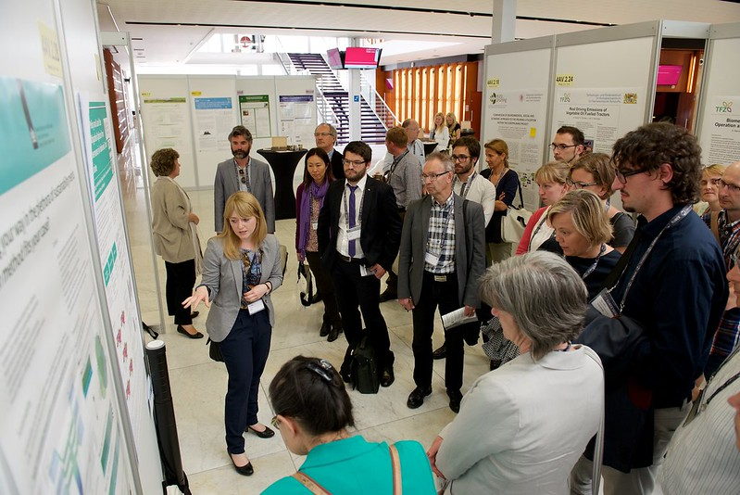
Title Goes Here
Subtitle goes here if needed
Author(s), Program(s) or Department(s), MacEwan University
Introduction
Methods
Conclusions
Avoid Creating a Text-Heavy Poster
Quickly communicate your research. Use:
Photographs
Tables & charts
Bullet points
Software
PowerPoint
Canva
In Design
LaTeX
Poster Size
Configure poster size before you start.
*In PowerPoint, go to the Design tab>> Slide Size>> Custom Slide Size.
36” x 48” is standard.
Section Headings
This template uses suggested headings commonly used in scientific posters. They are not required.
MacEwan Logo
Consider including a MacEwan logo.
Text
Use easy-to-read fonts:
Text size: 32-40 point.
Sections/headings: larger (e.g. 48 point).
Captions: smaller (e.g. 22 point).
Colour and Layout
Use colour to highlight and organize information.
Use contrast. Make sure your text is easy to read against background colours.
Printing
Before printing your poster:
Proofread it.
View it full screen.
Save it as a PDF.
Results
Where to print:
MacEwan Print Services https://tinyurl.com/yxttb78m
Images
Use high resolution images (300 dpi).
Avoid low-resolution web captures.
Include a caption description and any attribution information beneath photos.
Tables and Charts:
Ensure tables and charts match your colour scheme.
Give tables and charts a title.
Include a caption description.
References
Morrison, M. (2019). How to create a better research poster in less time (including templates) [Video]. YouTube. https://youtu.be/1RwJbhkCA58
Purrington, C. B. (2019). Designing conference posters. https://colinpurrington.com/tips/poster-design
Find copyright-friendly images: https://tinyurl.com/2ksbzp4t
Title of Table Example
Citation help: https://tinyurl.com/3uu3ayaw
 | Quantitative | Qualitative
Collection Methods | Structured | Semi-structured
Questions | Closed, limited options | Open
Data | Numerical | Textual
Acknowledgements
Acknowledge any agencies or individuals that helped with this project (e.g., your faculty mentor).
Description of this table
Title of Chart Example
Further Information
Optionally, include a QR code (https://www.qrcode-monkey.com) to link to additional information, e.g., a handout or paper.
Logo downloads available at: https://tinyurl.com/yt2zzbj6
Figure 1: Example of a poster session. Image (https://flic.kr/p/HUfaZ6) by EUBCE - European Biomass Conference and Exhibition is licensed under CC BY-NC-ND.
Description of this chart

